Slide 1
Lecture 9
Operating Systems (COMP1562)

Slide 2

Just talk about…
…kernels
Mariusz Pelc © 2009/2010
(with support from Dr Kevin McManus)

Slide 3
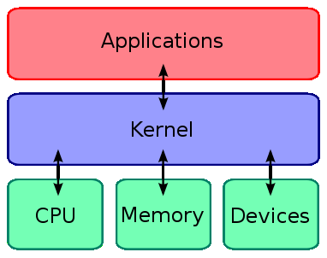
Kernel – what is it?
In computing, the kernel is the central component of most computer operating systems. Its responsibilities include managing the system's resources (the communication between hardware and software components).
Mariusz Pelc © 2009/2010
(with support from Dr Kevin McManus)

Slide 4
Kernel – basic facilities
The system kernel is responsible for managing of computer resources and allowing other processes and programs to run and use these resources. The resource in this case means:
The CPU - kernel decides at what time (and for how long) the running processes/programs should be allocated to the processor (or porcessors in multiprocessor systems)
The memory - kernel decides of which memory each process can use, and determines what to do when not enough memory is available
I/O devices - kernel allocates requests from applications to perform I/O to an appropriate device and provides convenient methods for using the device (hides details of the device/access implementation, only convenient interfaces are provided)
Mariusz Pelc © 2009/2010
(with support from Dr Kevin McManus)

Slide 5
Kernel design
Kernel design approaches :
Monolithic kernels
Microkernels
Monolithic kernels vs microkernels
Performances
Hybrid kernels
Nanokernels
Exokernels
Mariusz Pelc © 2009/2010
(with support from Dr Kevin McManus)

Slide 6
Kernel design – monolytic kernels
In a monolithic kernel, all OS services run along with the main kernel thread, thus also residing in the same memory area. This approach provides rich and powerful hardware access.
The main disadvantages of monolithic kernels are the dependencies between system components — a bug in a device driver might crash the entire system — and the fact that large kernels can become very difficult to maintain.
Mariusz Pelc © 2009/2010
(with support from Dr Kevin McManus)

Slide 7
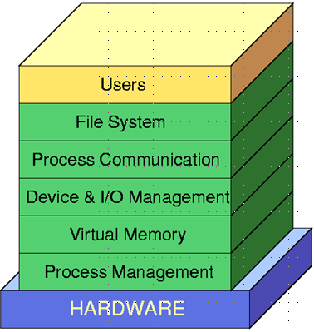
Kernel design – monolytic kernels
Some example systems with monolytic kernels:
FreeBSD
Linux
Microsoft Windows (except NT/2000)
Mac OS X
Mariusz Pelc © 2009/2010
(with support from Dr Kevin McManus)

Slide 8
Kernel design - microkernels
The microkernel approach consists of defining a simple abstraction over the hardware, with a set of primitives or system calls to implement minimal OS services such as memory management, multitasking, and inter-process communication. Other services, including those normally provided by the kernel such as networking, are implemented in user-space programs, referred to as servers.
Microkernels are easier to maintain than monolithic kernels, but the large number of system calls and context switches might slow down the system because they typically generate more overhead than plain function calls.
Mariusz Pelc © 2009/2010
(with support from Dr Kevin McManus)

Slide 9
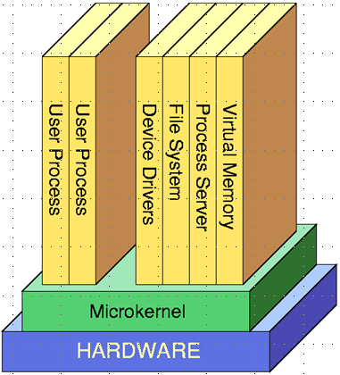
Kernel design - microkernels
Some example systems with monolytic kernels:
Amoeba
MINIX
QNX
BeOS
Haiku
Hurd
Mariusz Pelc © 2009/2010
(with support from Dr Kevin McManus)

Slide 10
Kernel design – microkernels - benefits
Small operating system core
Contains only essential operating systems functions
Many services traditionally included in the operating system are now external subsystems
device drivers
file systems
virtual memory manager
windowing system
security services
Mariusz Pelc © 2009/2010
(with support from Dr Kevin McManus)

Slide 11
Kernel design – microkernels - benefits
Portability
changes needed to port the system to a new processor is changed in the microkernel
not in the other services
Distributed system support
messages are sent without knowing what the target machine is
Object-oriented operating system
components are objects with clearly defined interfaces
Mariusz Pelc © 2009/2010
(with support from Dr Kevin McManus)

Slide 12
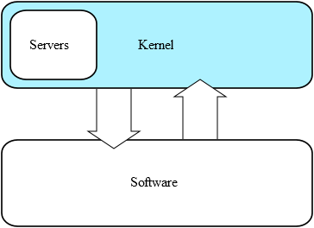
Kernel design – hybrid kernels
Hybrid kernels are a compromise between the monolithic and microkernel designs. This implies running some services (such as the network stack or the filesystem) in kernel space to reduce the performance overhead of a traditional microkernel, but still running kernel code (such as device drivers) as servers in user space. Basically, these kernels are of structure of microkernel but are implemented as monolythic
Mariusz Pelc © 2009/2010
(with support from Dr Kevin McManus)

Slide 13
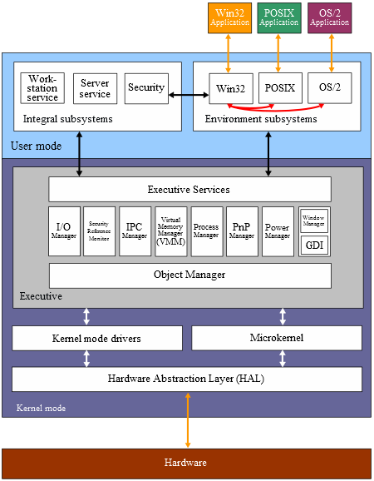
Kernel design – hybrid kernels
This is Windows NT/2000 kernel architecture. It consists of two main components: user mode and kernel mode.
The architecture comprises a simple kernel, hardware abstraction layer (HAL), drivers, and a range of services (collectively named Executive), which all exist in kernel mode.
User mode in Windows NT is made of subsystems capable of passing I/O requests to the appropriate kernel mode software drivers by using the I/O manager.
Mariusz Pelc © 2009/2010
(with support from Dr Kevin McManus)

Slide 14
Kernel design - nanokernels
A nanokernel (or picokernel) delegates virtually all services — including even the most basic ones like interrupt controllers or the timer — to device drivers to make the kernel memory requirement even smaller than a traditional microkernel.
The term picokernel was sometimes used to further emphasize small size of this kernel.
Mariusz Pelc © 2009/2010
(with support from Dr Kevin McManus)

Slide 15
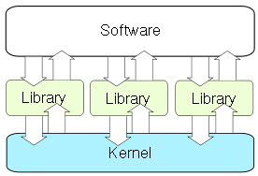
Kernel design - exokernels
An exokernel is a type of kernel that does not abstract hardware into theoretical models. Instead it allocates physical hardware resources, such as processor time, memory pages, and disk blocks, to different programs. A program running on an exokernel can link to a library operating system that uses the exokernel to simulate the abstractions of a well-known OS, or it can develop application-specific abstractions for better performance.
Mariusz Pelc © 2009/2010
(with support from Dr Kevin McManus)

Slide 16
Kernel - Windows Operating System
System kernel is usually implemented as a file (or a number of files), which is being executed (or loaded into the memory) during the system startup.
In case of Windows system the core kernel files are:
ntkrnlpa.exe - this kernel image file in system32 folder for all Windows systems, which supports PAE (Physical Address Extension - the memory extension feature of 32 and 64-bit, the system makes use of its physical memory and the system performance increases). This process is the root program of Windows Kernel, which provides various essential components and system services to the system, without which the system cannot boot.
ntoskrnl.exe -this is the kernel image. Since it provides Executive and Kernel layers of Windows NT kernel space, the file serves as the critical component of Windows NT boot process. Its functions also include providing several fundamental system services.
Mariusz Pelc © 2009/2010
(with support from Dr Kevin McManus)

Slide 17
Kernel - Linux Operating System
Linux system is an operating system of Open Kernel. This means, that everyone can access the kernel sources. To make the matters more interresting, everyone can configure and kompile the system kernel to make it fit his needs.
In case of Linux system the core kernel files are:
/boot/vmlinuz-kernel_version - this the Linux system kernel image; actually, in the Linux system in the /boot directory there may be many kernels and after prior configuration of boot loader (later this was LILO program, currently GRUB program is used) any of them can be used at boot-time, so that the system might be booted to satisfy some very specific requirements (for example some kernel configuration may increase system performance, the other ones may increase its efficiency regarding resources usage).
Mariusz Pelc © 2009/2010
(with support from Dr Kevin McManus)

Slide 18
Kernel - Linux Operating System
/boot/System.map -this is the kernel map file. In simple words – this file maps kernel symbols (functions, constants, etc.) so that the in case of any problem it was clear where exactly the problem was.
Mariusz Pelc © 2009/2010
(with support from Dr Kevin McManus)

Slide 19
Kernel - Linux Operating System
For example, in case of a service fails, there is dropped current content of processsor registers. In particular the contents of the EIP (instruction pointer) is printed. Like this:
EIP: 0010:[<00000000>]
Call Trace: [<c010b860>]
So the problem occured with a symbol c010b860. What does it mean? Thank’s to System.map file the klogd (kernel logs daemon) intercepts the error report and can translate the symbol into the right name before the error information is logged. In the example the symbol c010b860 is translated into BytesRead() symbol. It is important to have the System.map file adequate for the currently used kernel version, otherwise the translation will be misleading (as in the „wrong” map file the symbol will have different meaning).
Mariusz Pelc © 2009/2010
(with support from Dr Kevin McManus)

Slide 20
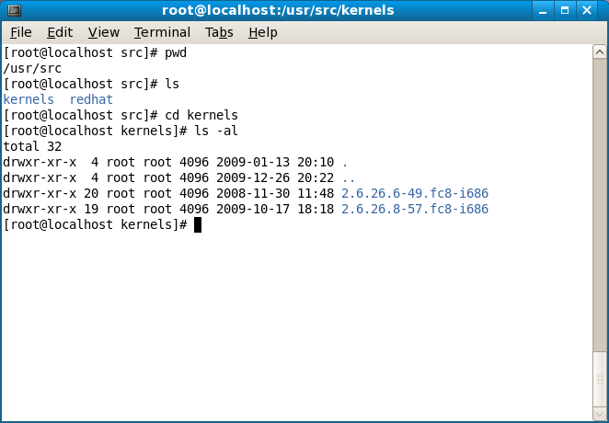
Kernel - Linux Operating System – kernel sources
Mariusz Pelc © 2009/2010
(with support from Dr Kevin McManus)

Slide 21
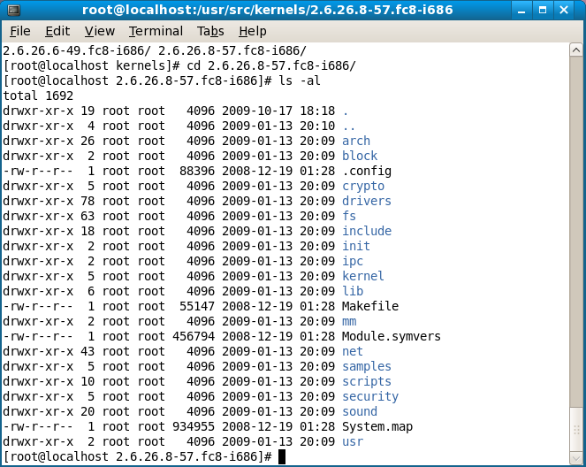
Kernel - Linux Operating System – kernel sources
Mariusz Pelc © 2009/2010
(with support from Dr Kevin McManus)

Slide 22
Kernel - Linux Operating System – kernel sources
Makefile rules:
make config - kernel configuration in pure text mode (takes ages, avoid if you can)
make menuconfig - kernel configuraiton in window text mode
make xconfig - kernel configuration in window graphical mode
make clean - clenup after previous configuration / compilation
make - kernel compilation
make image/zImage - creation of the kernel file
make install - installation of the compiled kernel
make modules - compilation of loadable modules
make modules install - installation of the loadable modules
Mariusz Pelc © 2009/2010
(with support from Dr Kevin McManus)

Slide 23
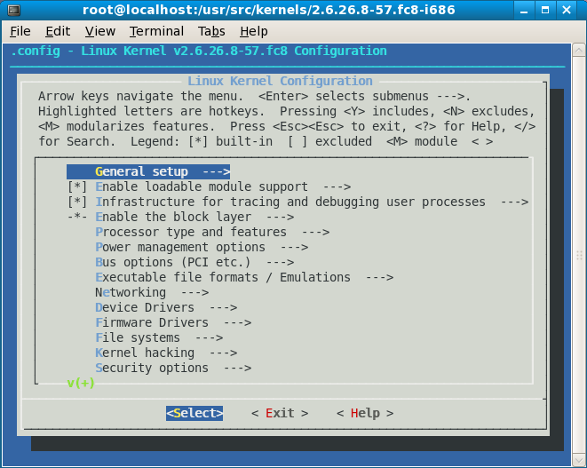
Kernel - Linux Operating System – kernel sources
Mariusz Pelc © 2009/2010
(with support from Dr Kevin McManus)

Slide 24
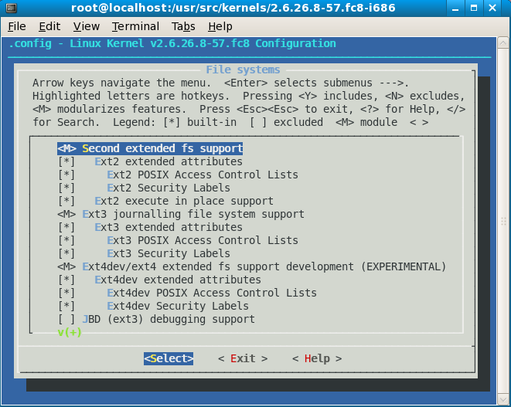
Kernel - Linux Operating System – kernel sources
Mariusz Pelc © 2009/2010
(with support from Dr Kevin McManus)

Slide 25
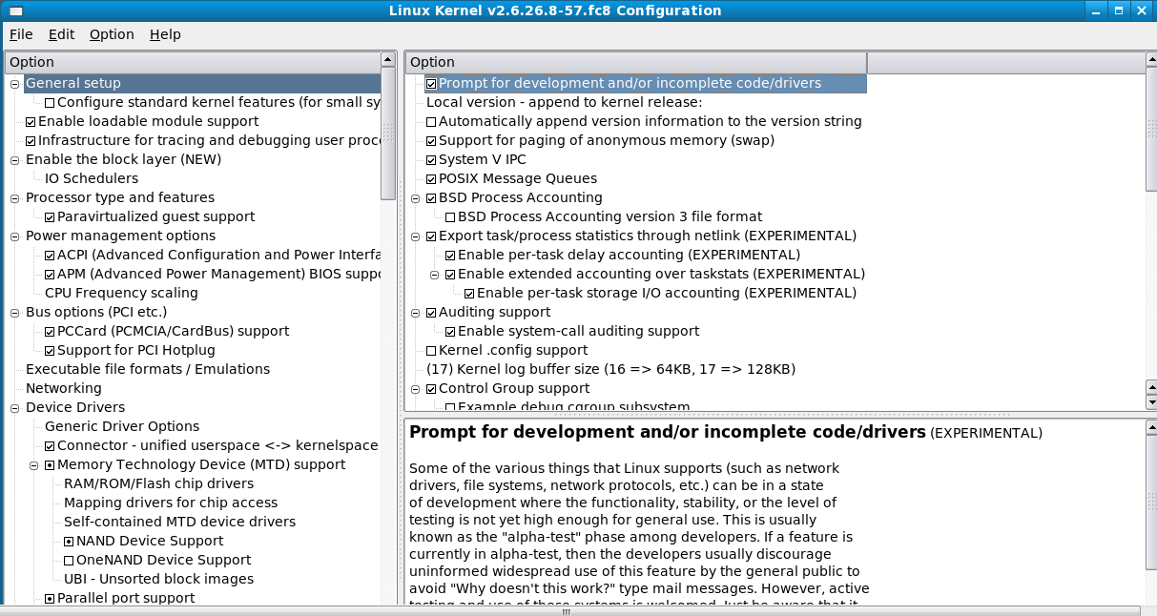
Kernel - Linux Operating System – kernel sources
Mariusz Pelc © 2009/2010
(with support from Dr Kevin McManus)

Slide 26
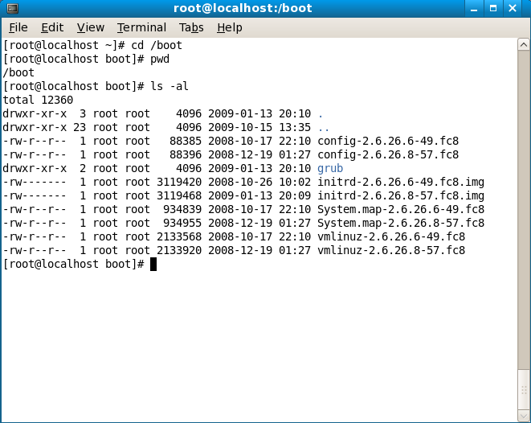
Kernel - Linux Operating System – kernel sources
Mariusz Pelc © 2009/2010
(with support from Dr Kevin McManus)

Slide 27
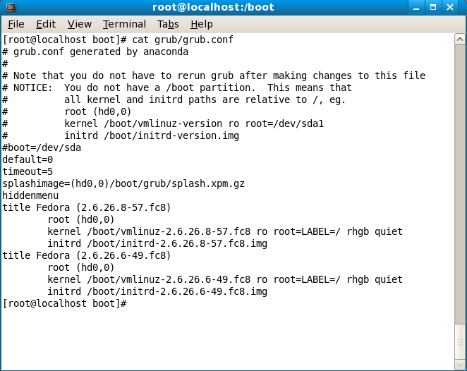
Kernel - Linux Operating System – kernel sources
Mariusz Pelc © 2009/2010
(with support from Dr Kevin McManus)

